Slide 1
Pitching The Game
Selling Your Idea
FB: benardhp
Page: mrbenz19
Steam: mrbenz19

Slide 2
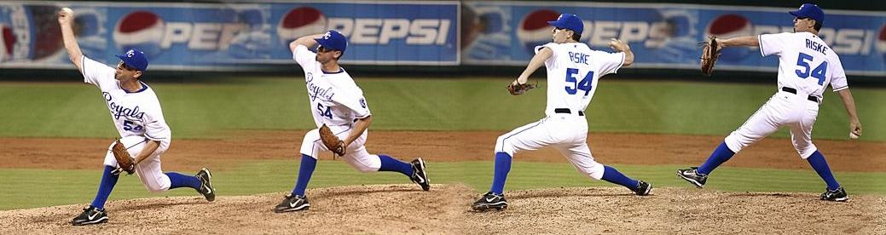
What is Pitch?
GAME
Explain
Sell
Your Game

Slide 3
Why do you need to pitch?
Let the audience know about your game
Make the audience interested in your game
Make you think about many aspects of your game

Slide 4



Know Your Audience
Who are you pitching to and what for?
Understand their need
Know their taste

Slide 5


Know Your Audience
In document or direct presentation?
Less or more detailed

Slide 6
Type of Pitches
Elevator Pitch
Oral
Outline of the game
One Page Pitch
One page filled with info about the game
Full Pitch
All around Idea of your game

Slide 7

Elevator Pitch
Accidentally meet an important person in the elevator
Time limit: 1 elevator ride (est. 1-2 minute)
Objective: Make them want to hear more of your idea
Get a scheduled meeting
Continue the talk

Slide 8
Elevator Pitch
Need to be brief
Need to be on point
Focus on the main gameplay and unique selling point
Use popular reference/idea to help explain
A meet B in Space!!

Slide 9

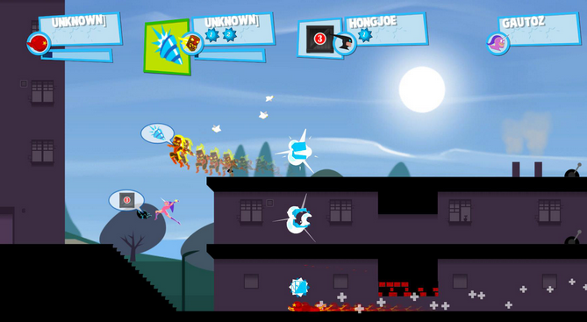
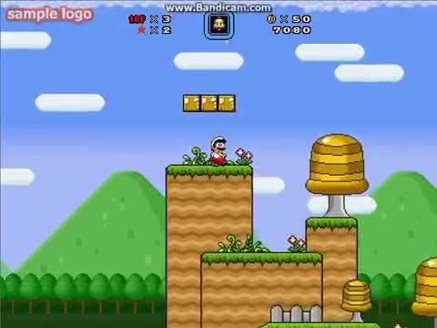
Elevator Pitch
Speedrunner

Slide 10
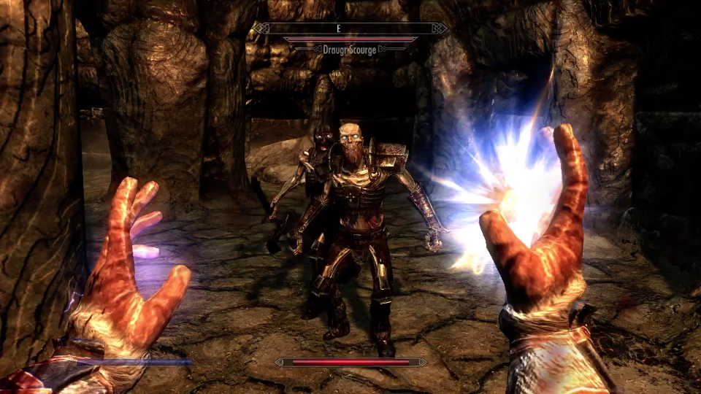
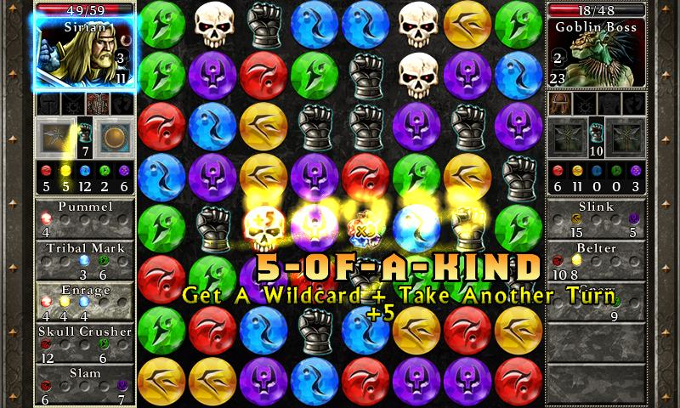
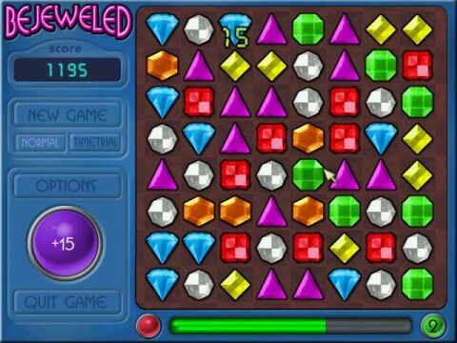
Elevator Pitch
Puzzle Quest

Slide 11

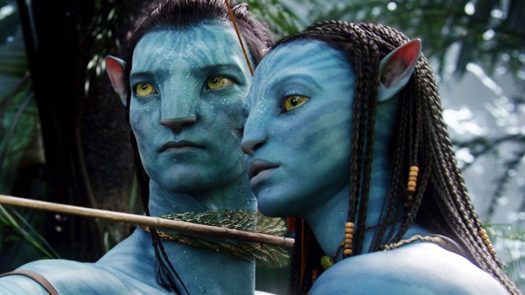
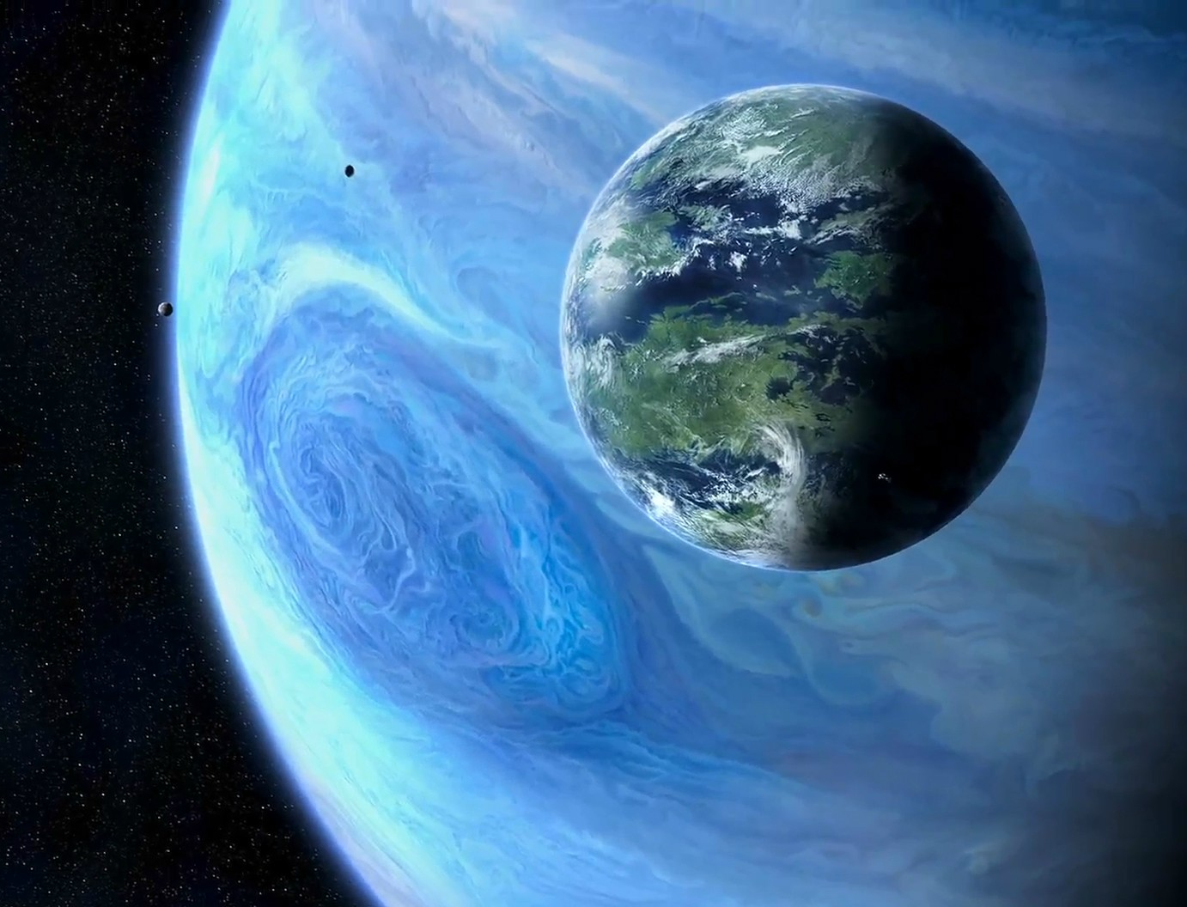
Elevator Pitch
Avatar
Not the bald kid

Slide 12
Elevator Pitch
Checklist
What the game is like?
Comparison
Genre
Platform (if important)
What players do in the game?
What is different/new in your game?

Slide 13

One Page Pitch
Expansion of Elevator Pitch
Less detailed than Full Pitch
Objective: Make them interested in your game
Move to the Full Pitch
Limit:
One Page

Slide 14
One Page Pitch
Interesting
Clear
Short and meaningful
(like this page)

Slide 15
One Page Pitch
Checklist
What the game is like?
Comparison
Genre
Platform (if important)
What players do in the game?
What is different/new in your game?
(Iya ini cuma copy paste dari yang elevator pitch)
More detailed than Elevator Pitch

Slide 16

Full Pitch
First of all:
Good job!
Time limit: 10-30 minutes
Objective:
Make them interested with your idea
Make them want to help you

Slide 17
Full Pitch
Need to be clear
Different audience = different points to focus on
Rule of thumb:
gameplay
unique selling points
why people want to play your game

Slide 18
Full Pitch
Checklist
What the game is like?
Comparison
Genre
Platform
Who is your target?
Selling points
What players do in the game?
What is different/new in your game?
Who are the competition?
(Freemium) How does the game makes their money?
Why people want to play the game?

Slide 19
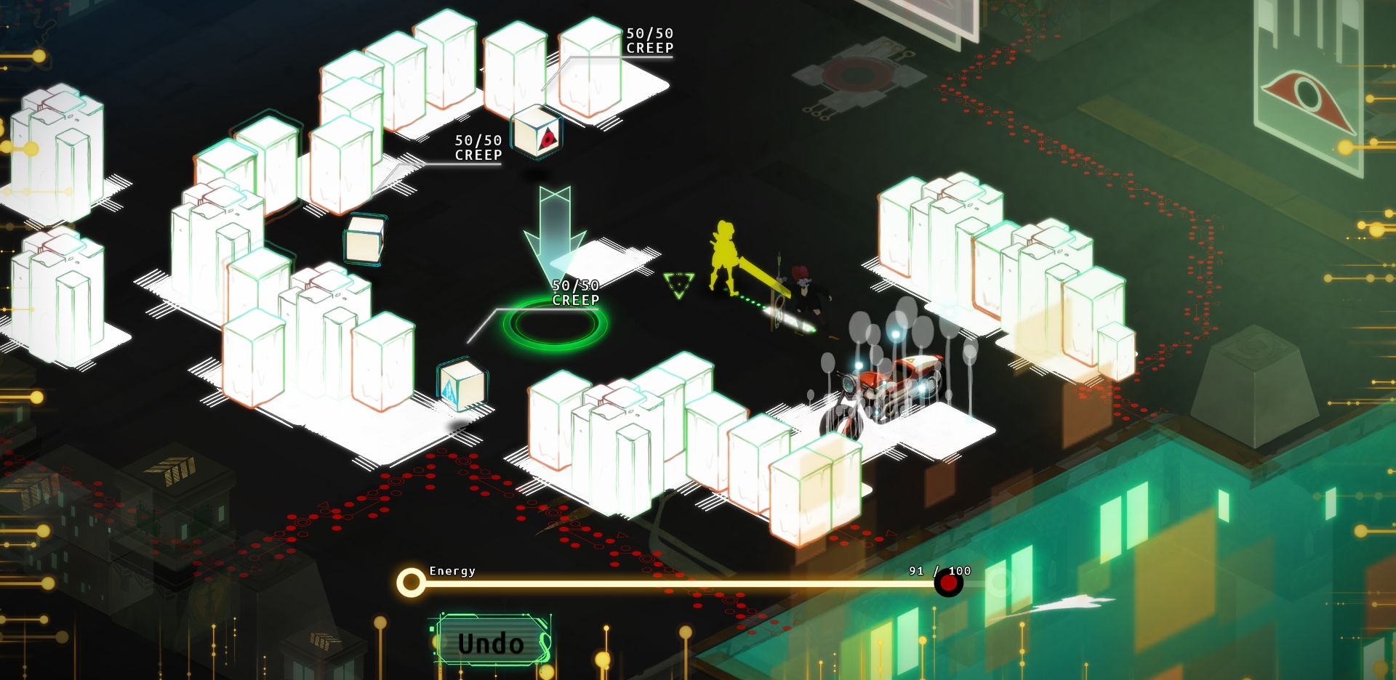
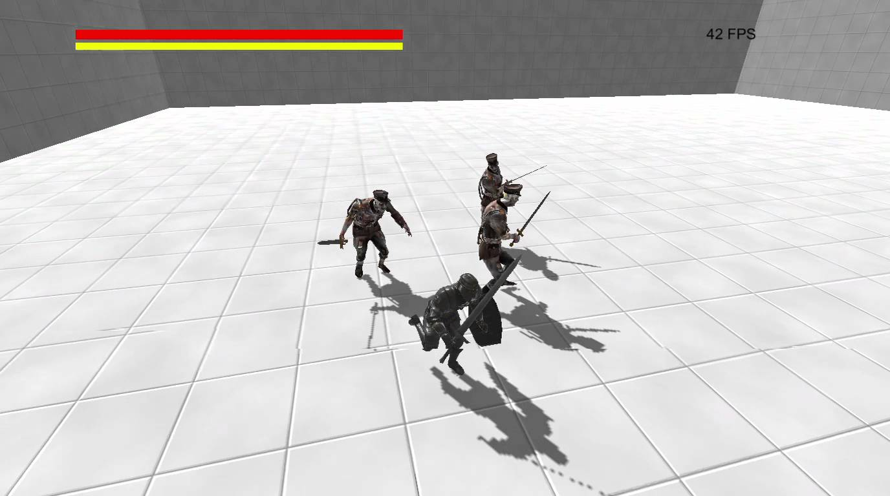
Full Pitch (Bonus Point)
Mock - Up Video
A trailer could explain your game better
Make clearer image of your game
Playable Demo/Prototype
Nothing beats playing the game first-hand
Focus on main gameplay and ‘the feel’ of the game

Slide 20
Explaining The Game
DO
DON’T
Simple and short
Use familiar example
Be too detailed
Too long
Using obscure example or not at all

Slide 21

‘This game is an RPG set in a similar world to us. But, their world also have monsters, magics, swords, and knights. Player will follow the story of a young prince and his 3 aides……’
‘An RPG about four friends going on a road trip in a modern world setting but with magics, swords, and monsters told with an epic story’

Slide 22
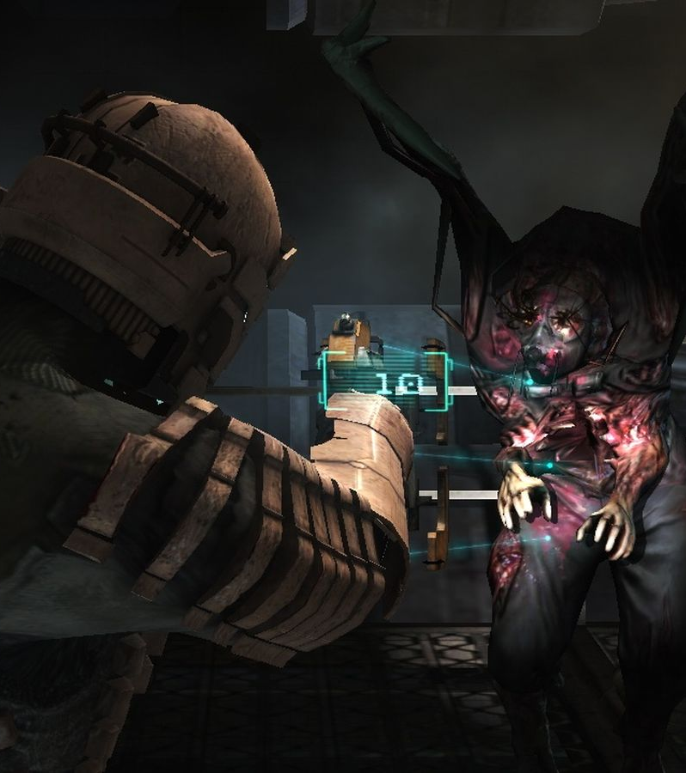
‘A third person shooter survival horror game set in a space colony’
‘Resident Evil 4 IN SPACE!!!’

Slide 23
Target Market
DO
DON’T
More specific target
Gamer type
Gender
Age
Location
etc.
“EVERYONE!”

Slide 24


Hardcore gamer
Mostly male
Age: 15 - 35
Casual gamer
Male & Female
Age: 5 - 25
Fans of Despicable Me

Slide 25
Gameplay
DO
DON’T
Explain the core gameplay
Simple and to the point
Use mock up, images, and flowchart
Explain the non-core too much
Way too detailed
Too many long sentences

Slide 26
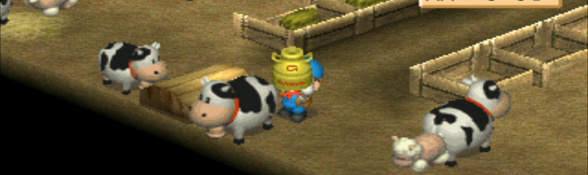
Player can get sheeps, cows, and chickens. Each will produce their own products. Player needs to feed them so they will lay eggs, etc. If they have big affection to player, they will produce better product. To raise affection, player need to feed them, brushes them, and pet them.
Plant crops
Take care of livestock
Romance girls

Slide 27
Selling Points
DO
DON’T
Something really unique from the game
Something that the target market wants
Being too general
Use something that’s too common

Slide 28
Presentation
DO
DON’T
Compact words
Less text, more speaking
Bullet points
More illustration
More slides if needed
Be confident
Too many text in one slide
Long sentences
Let the slide explain
All over the place

Slide 29
Question?

